Slide 1
Entity Relationship Diagram 3/3
School of Computing and Engineering

Slide 2
Learning Objectives
Understand Normalisation technique following three process:
1NF
2NF
3NF

Slide 3
Lecture Plan
Recap from the last lecture 5min
Normalisation technique 35min
Class Exercise 15min

Slide 4
Recap from the previous lecture
What is an identifier?
Identifier can uniquely identify one instance of an entity.
All entities have one attribute as their identifier.

Slide 5
Normalisation
Normalisation is a technique that can help analysts validate the data models.
It is a process whereby a series of rules are applied to a logical data model to determine how well formed it is.
The result of normalisation process is that the data attributes are arranged to form stable yet flexible relations for the data model.
There are three steps of normalisation.
1NF: Remove repeating groups/attributes
2NF: Remove Partial Dependencies
3NF: Remove Transitive Dependencies

Slide 6
First Normal Form – 1NF
A logical data model is in first normal form if it does not contain attributes that have repeating values for a single instance of an entity.
Repeating attributes should be removed.
Create another entity to place the repeating attributes.
Every attribute in an entity should have only one value per instance for the model to pass 1NF.

Slide 7
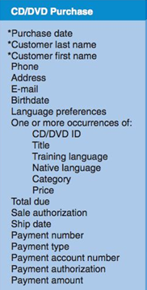
The first repeating group of attributes are about CD/DVD which should be removed and placed in a new entity called CD/DVD. Language preferences attribute includes the languages of interest to the customer (e.g. French, Italian, Germany and etc). This is also a repeating attribute as many different preferences may be captured for each instance of a sale.

Slide 8
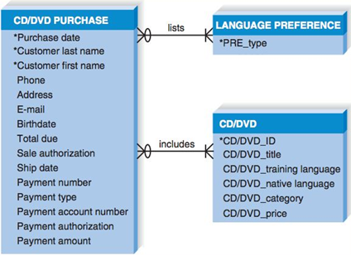
The new entities have M:N relationships with CD/DVD Purchase entity.
We care resolve this by using intersection entity.

Slide 9
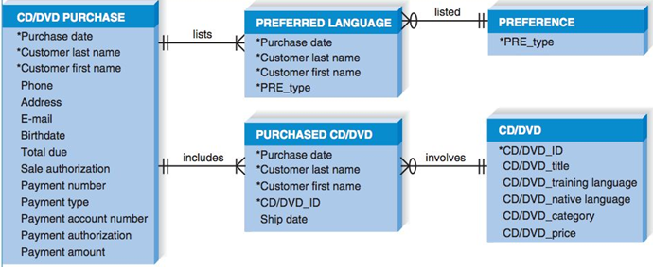
A new intersection entity was inserted between CD/DVD Purchase and CD/DVD. Also between CD/DVD Purchase and Preference.
Attribute Ship date was moved to Purchased CD/DVD because the various CD/DVDs in a purchase may ship at different dates.

Slide 10
Second Normal Form – 2NF
Once the data model is in 1NF we check if the model is in 2NF.
All entities should contain attributes that are dependent on the whole identifier this means that the value of all attributes that serve as identifier can determine the value for all of the other attributes for an instance in an entity.
Non-identifier attributes are dependent on only part of the identifier (partial dependency) and these attributes belong in another entity.

Slide 11
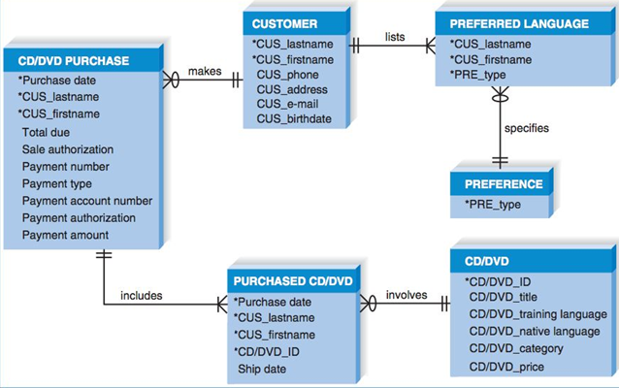
The three attributes from CD/DVD Purchase used identifiers were moved to a new entity (Customer). The problem was that some of the attributes were dependent on the customer last name and first name but had no dependency on purchase date.

Slide 12
Third Normal Form – 3NF
The model should be in 2NF. No attributes is dependent on a non-identifier attribute (transitive dependency).
If there are attributes dependent on a non-identifier attributes, then they should be removed and placed in a new entity.
There are attributes in CD/DVD Purchase that depend on the payment number not the CD/DVD purchase date and customer first, last names.
The payment type, account number, authorisation and amount depend on the payment number (a non-identifying attribute)

Slide 13
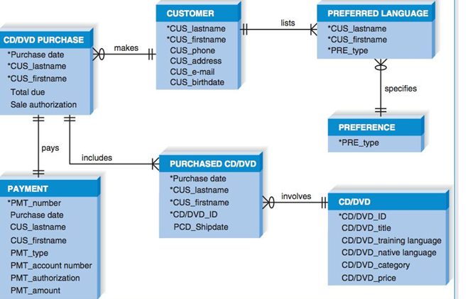
We create a new entity (Payment) and move payment attributes to it.

Slide 14
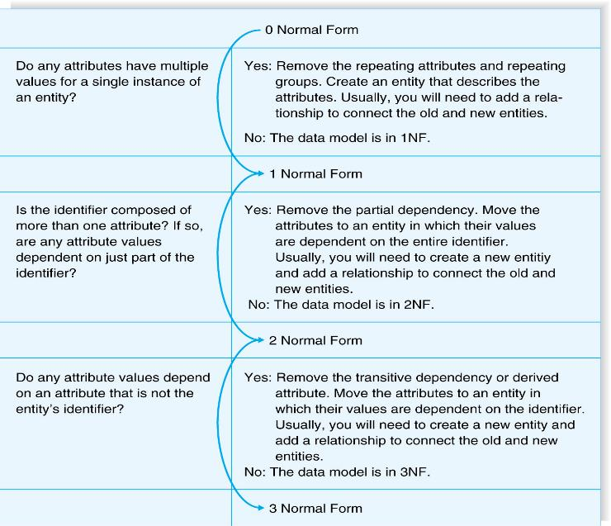

Slide 15
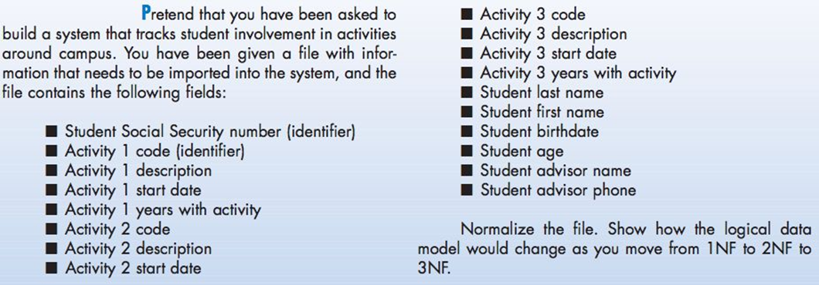
Activity 1

Slide 16
Activity 2
Apply 1NF, 2NF and 3NF to the following model of Sales Report:

Slide 17
References
Dennis, A., and Wixom, B. H, “Systems Analysis and Design”, 5th Edition, John Wiley & Sons (2013), Chapter Six.

